Slide 1
An Opinionated Approach to ASP.NET Core
(50 opinions, to be exact)
K. Scott Allen
@OdeToCode

Slide 2
Solutions and Projects
Controllers
C# Code
Views
Startup
Client Code
Tests

Slide 3

Solutions & Projects
3

Slide 4
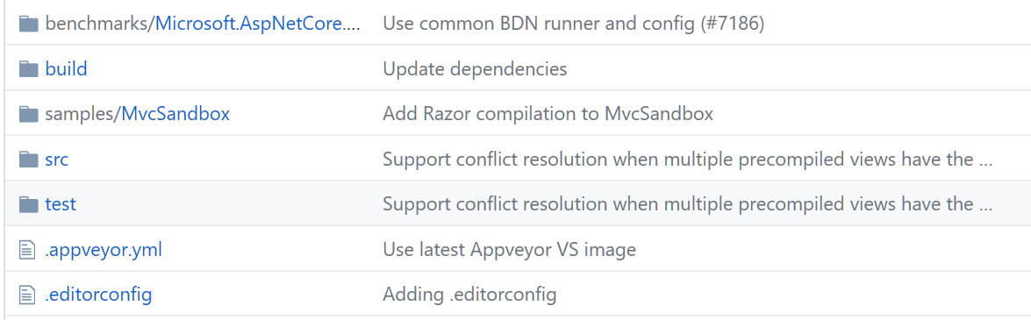
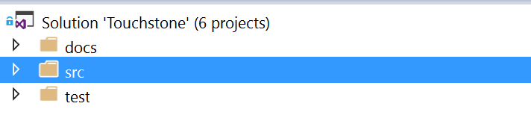
Use a Standard Repo Structure

Slide 5
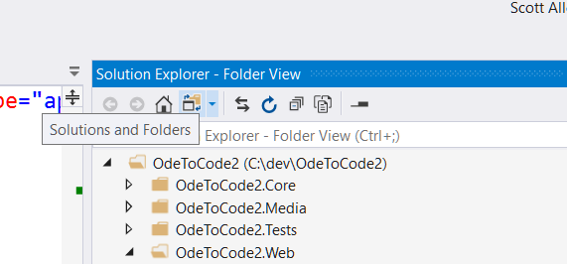
Use Folder View

Slide 6
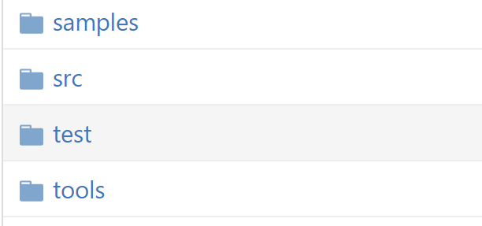
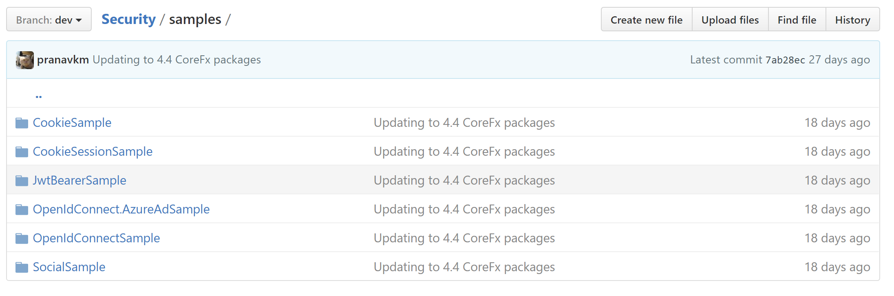
Include Samples & Tools

Slide 7
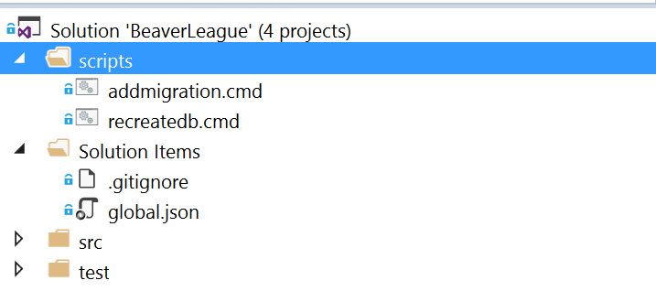
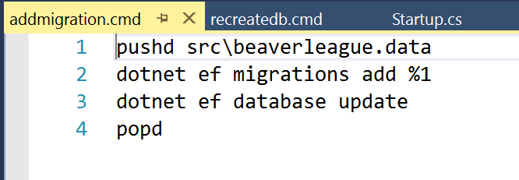
Include Development Scripts

Slide 8
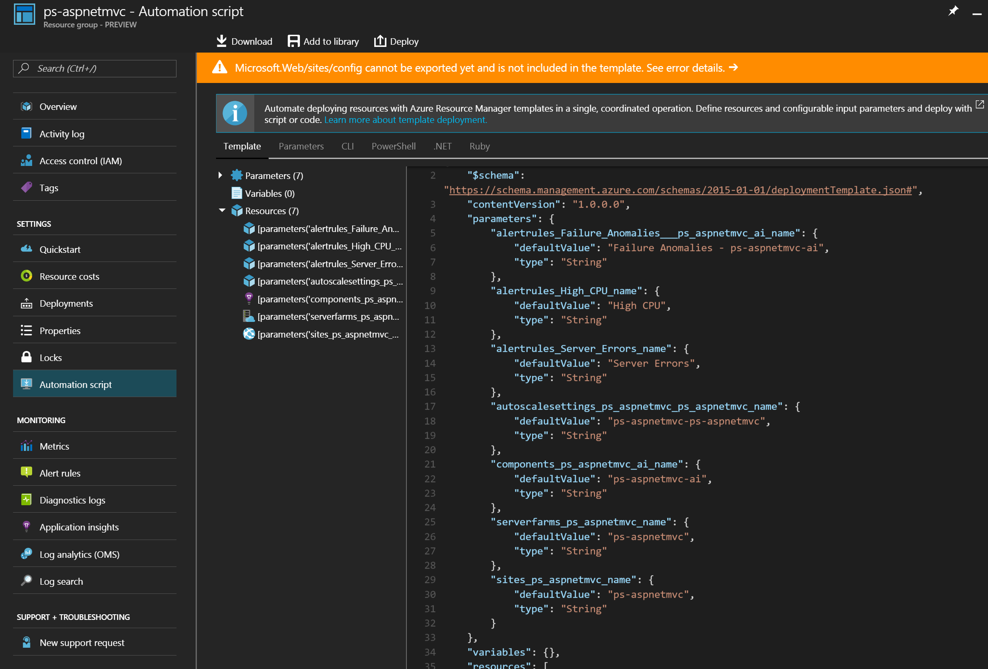
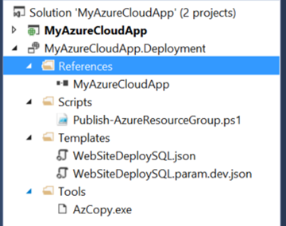
Include Deployment Scripts & Templates

Slide 9
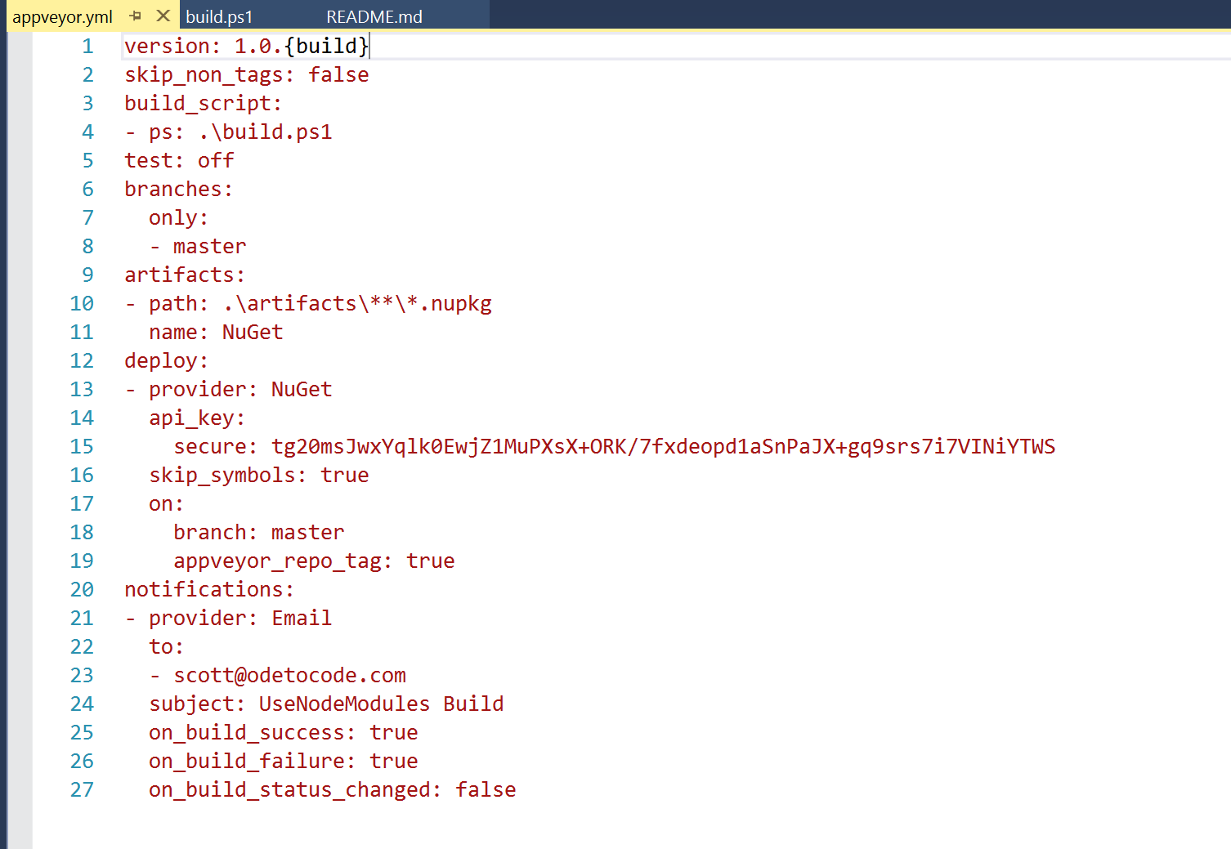
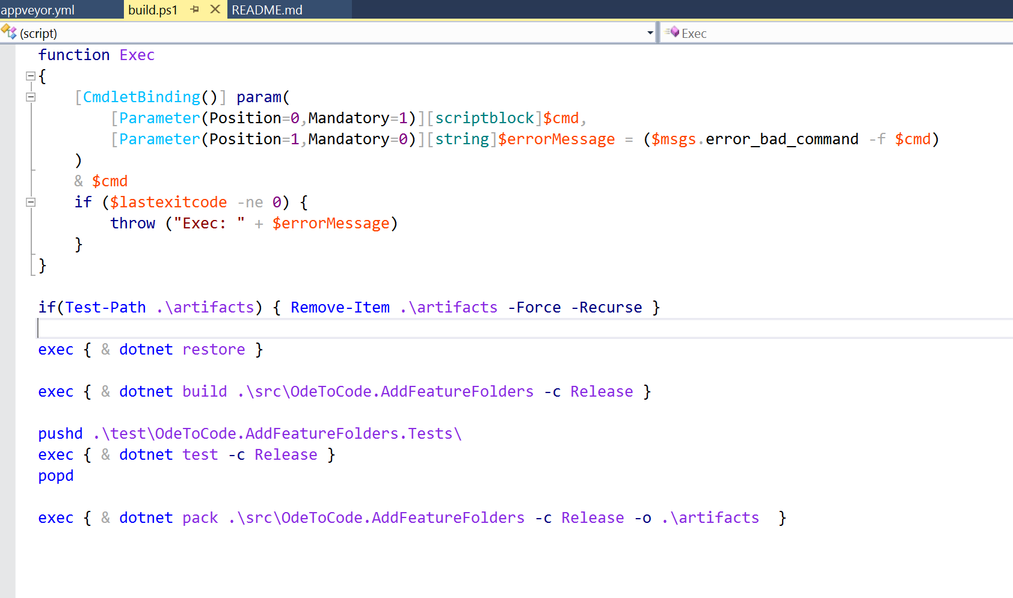
Use AppVeyor YAML for Builds Instead of UI

Slide 10
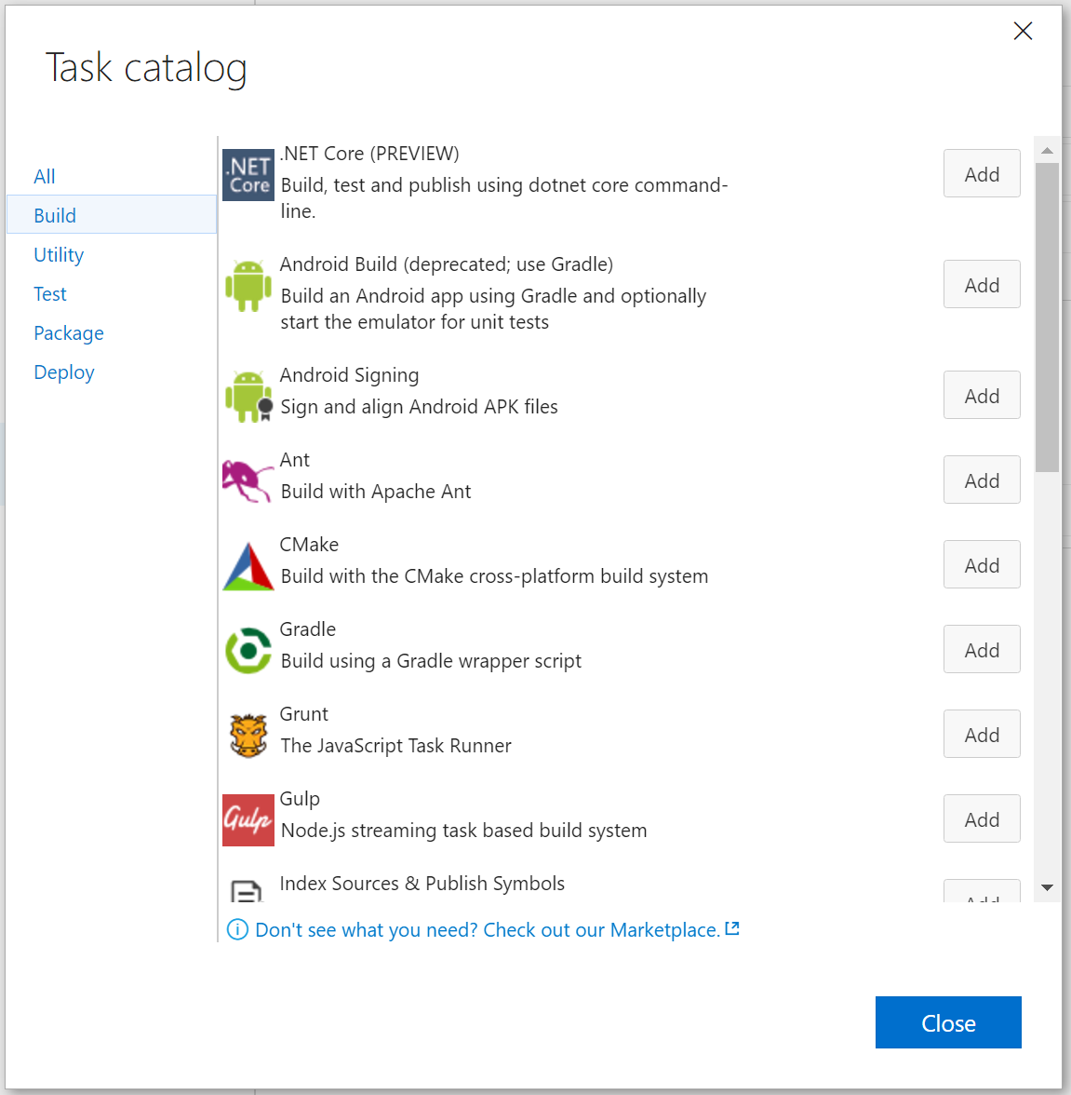
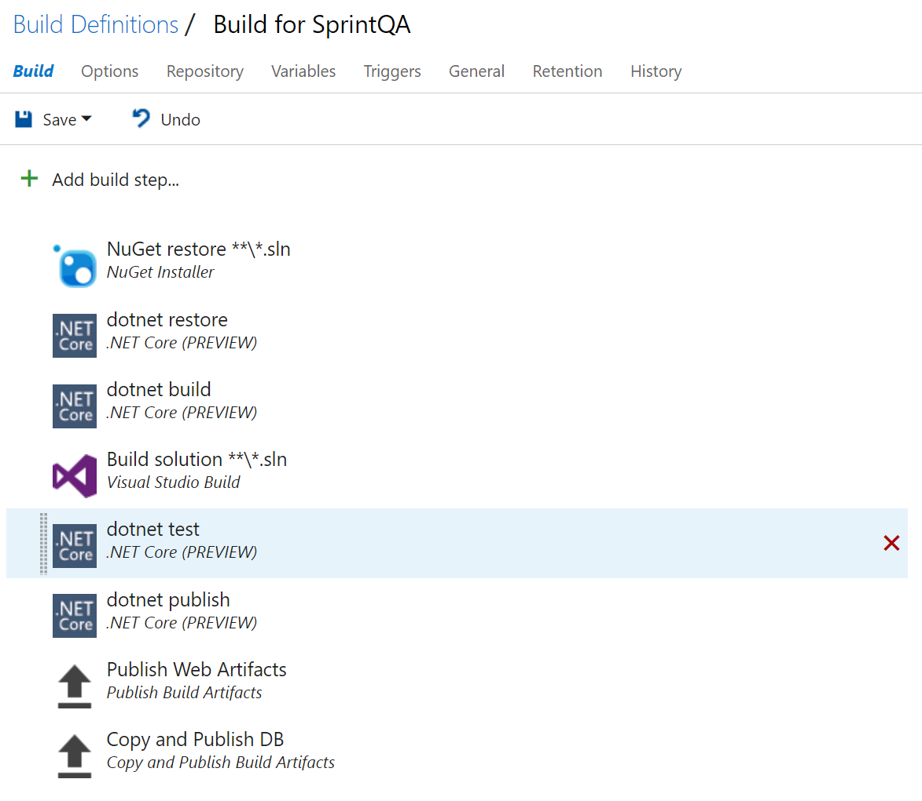
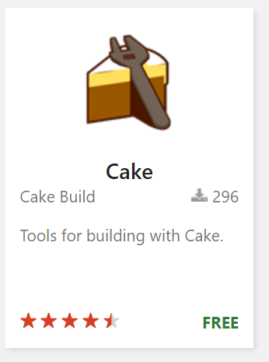
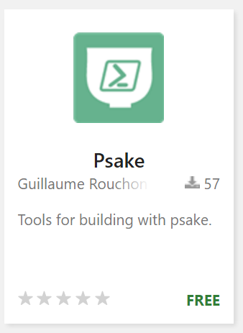
Use YAML for VSO Builds (and Releases!)

Slide 11

Startup
11

Slide 12
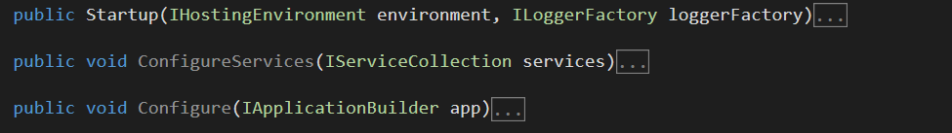
Only Use Startup for Services and Middleware
Three responsibilities

Slide 13
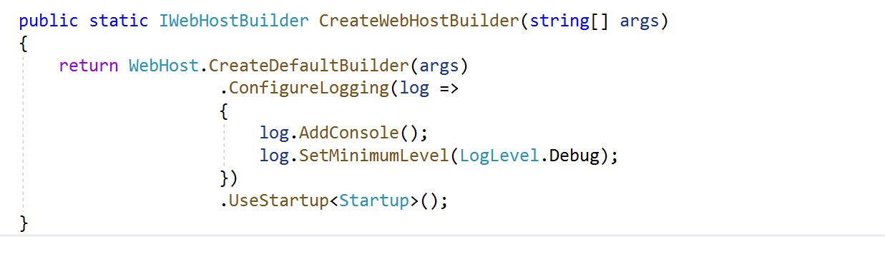
Logger Is Configured Before Middleware
Leave Configure for middleware only

Slide 14
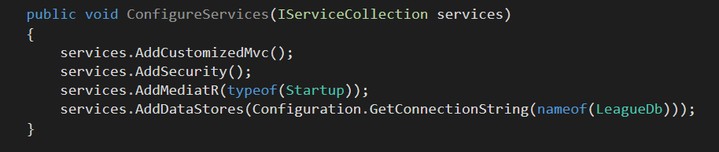
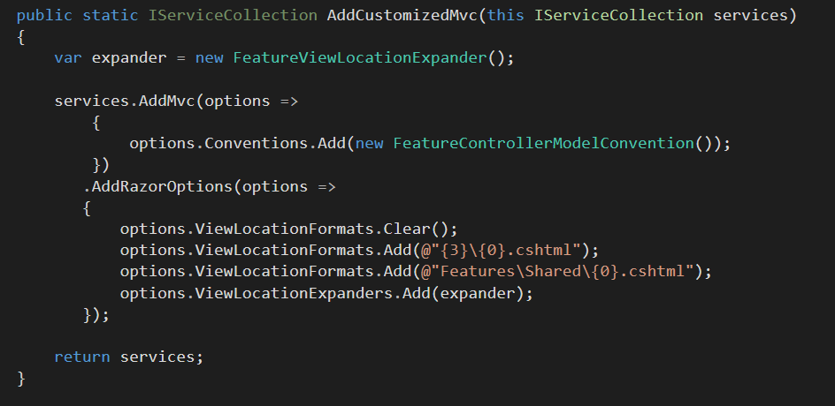
Keep Configure Methods Clean

Slide 15
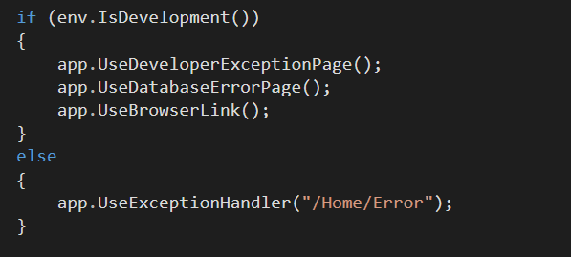
Configure Is Allowed To Branch

Slide 16
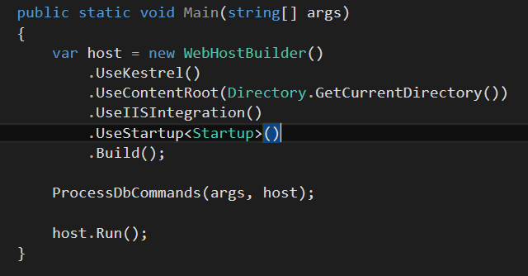
Make Use Of Your App As Executable

Slide 17
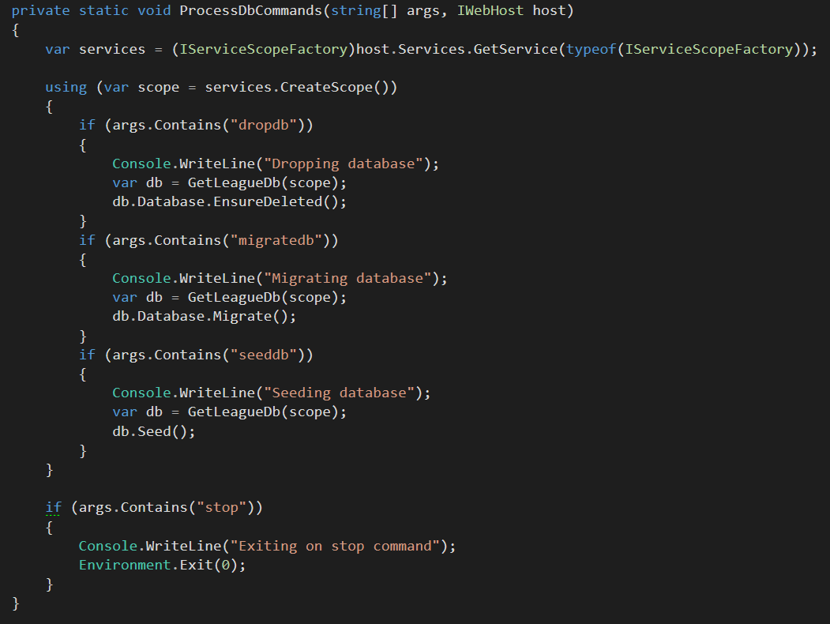
Always Use IServiceScopeFactory During Startup

Slide 18
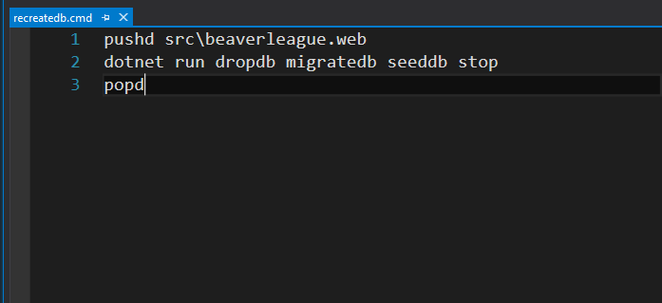
Add Scripts To Make Startup Parameters Easy

Slide 19
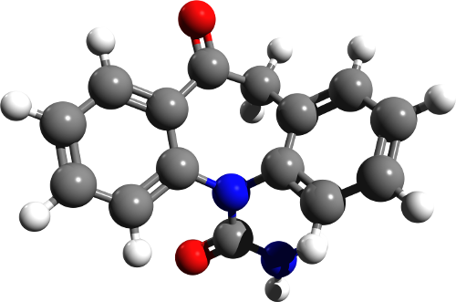
Project
Structure
21

Slide 20
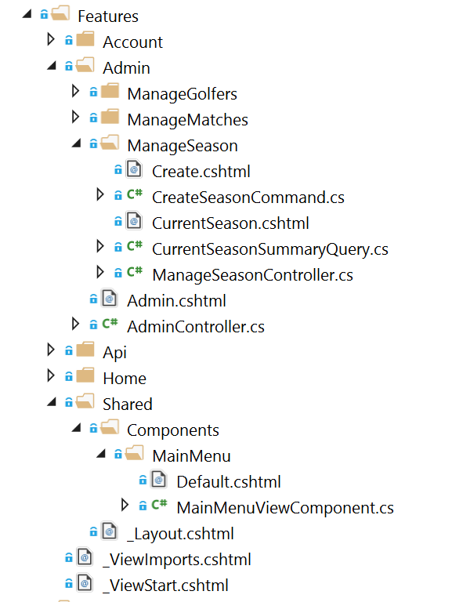
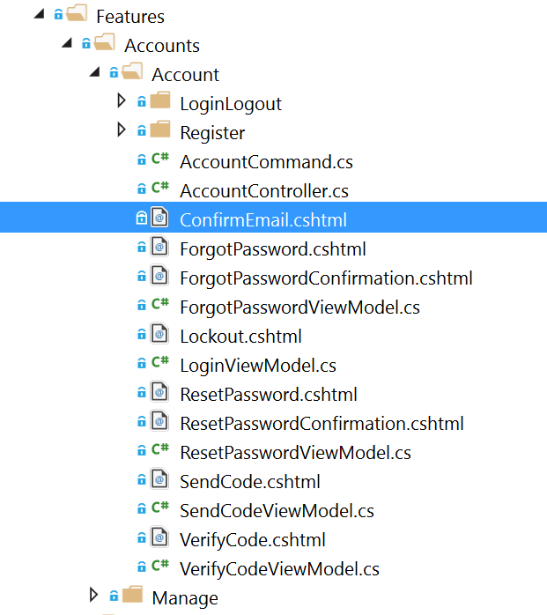
Feature Folders

Slide 21
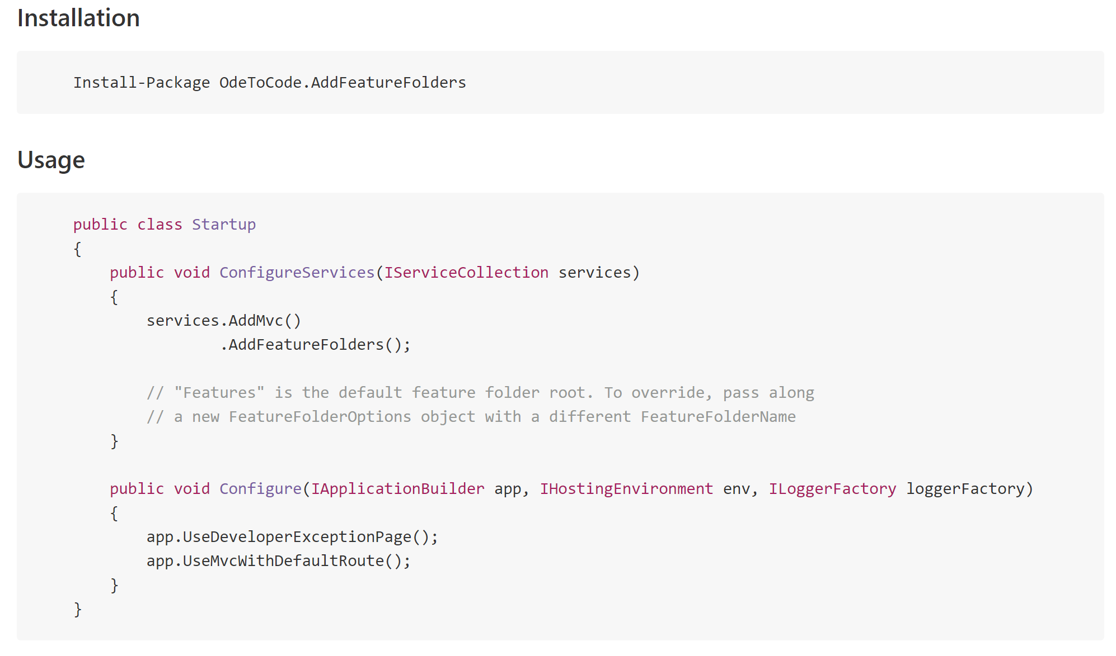
Feature Folders Are Easy

Slide 22
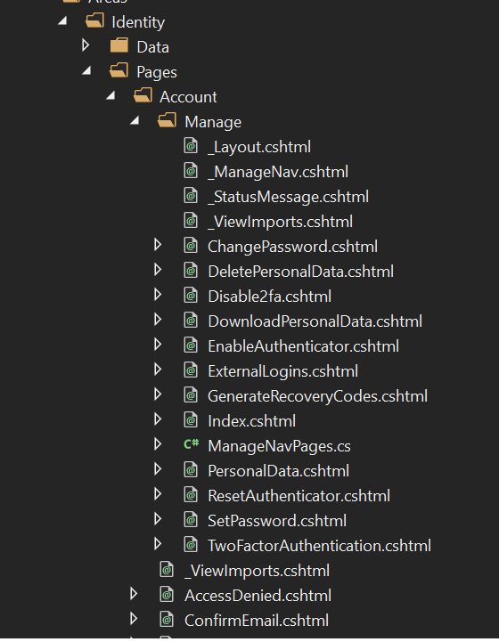
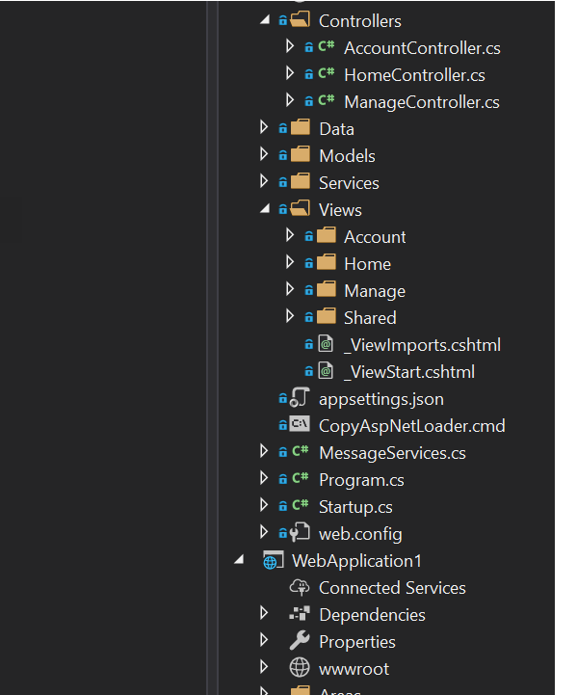
Identity Razor Pages
Identity MVC

Slide 23
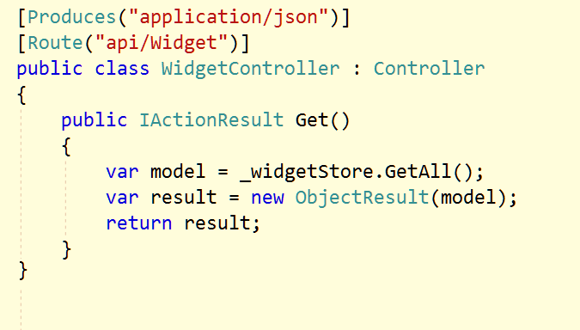
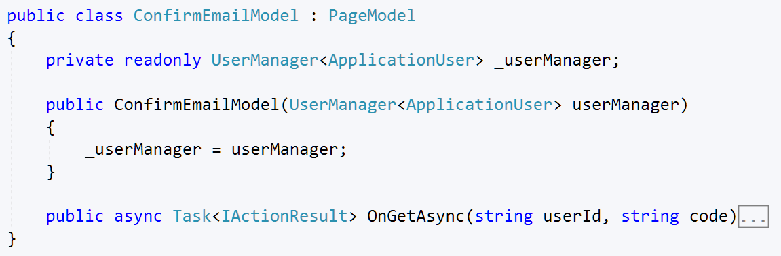
Controllers for APIs / Razor Pages for HTML

Slide 24
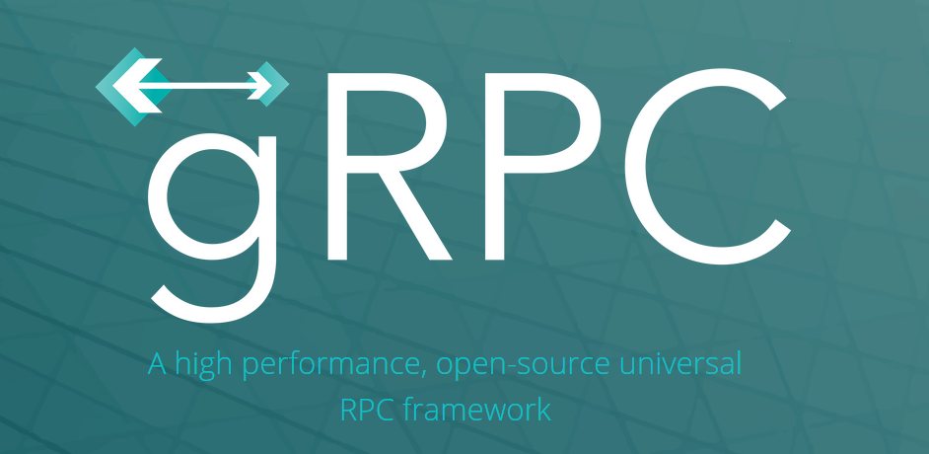
Controllers for Open APIs, gRPC for closed APIs

Slide 25

Controllers
24

Slide 26
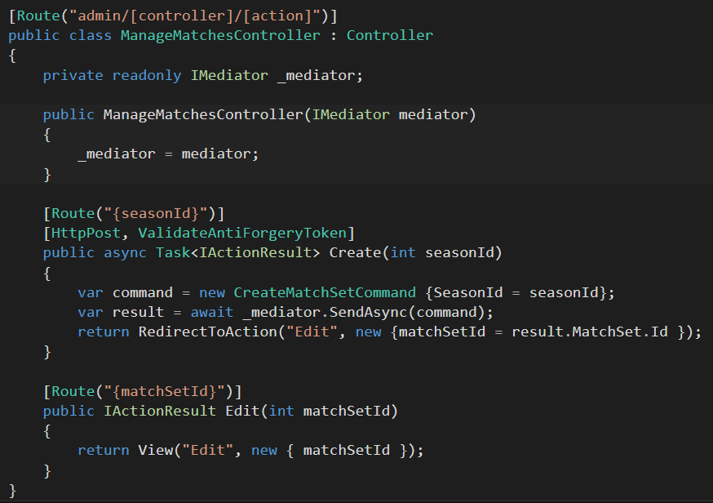
Route using [Route]

Slide 27
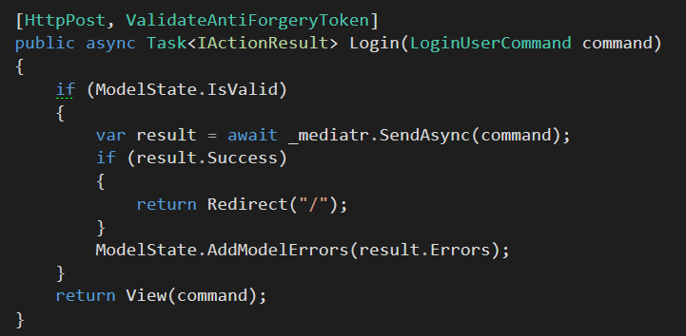
Think About Mediatr

Slide 28
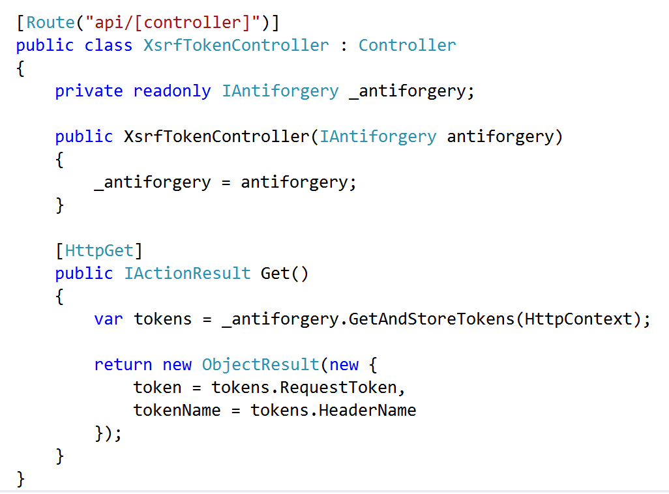
Don’t Forget XSRF in APIs

Slide 29
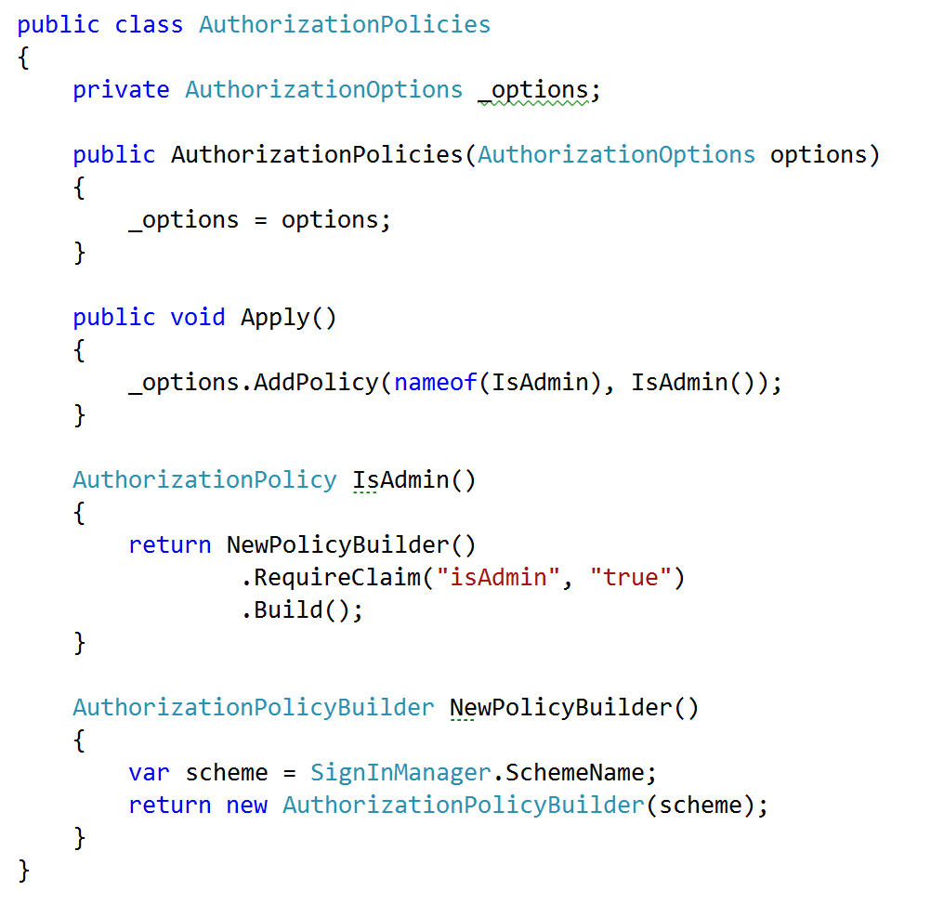
Embrace Security Policies

Slide 30
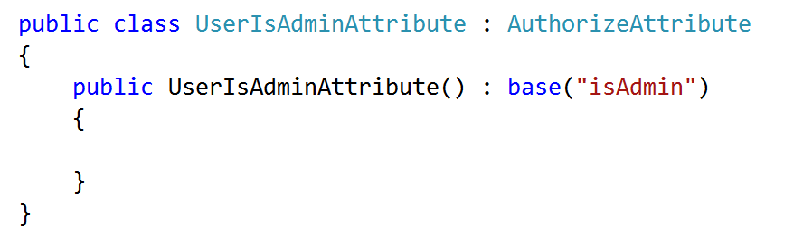
Create Custom Authorize Attributes

Slide 31
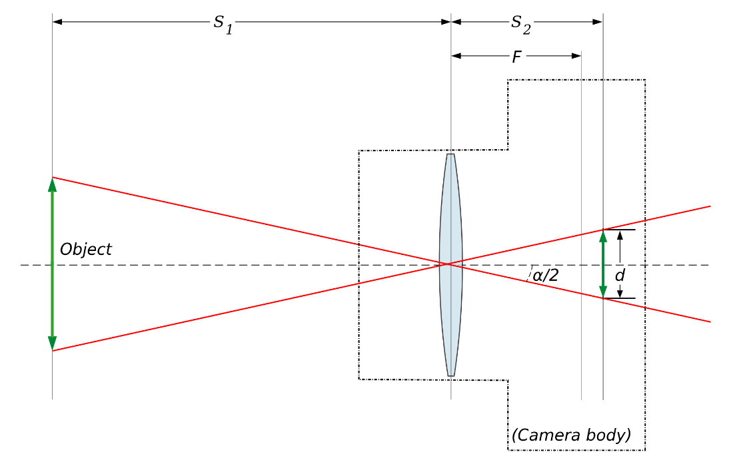
Views
32

Slide 32
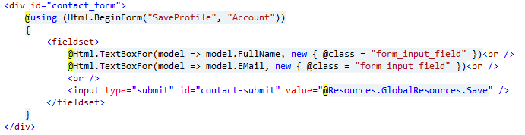
Avoid HTML Helpers

Slide 33
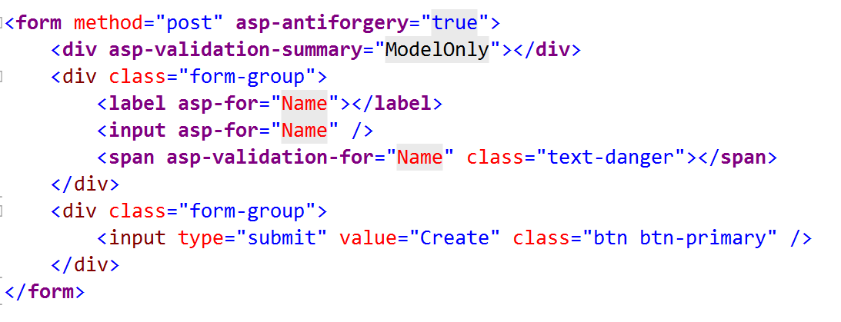
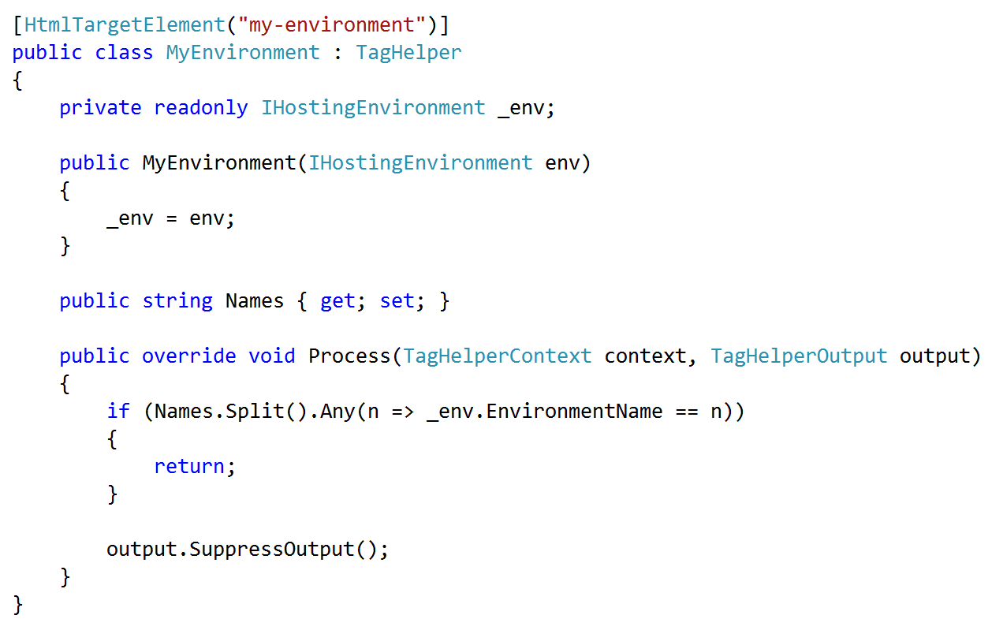
Embrace & Extend Tag Helpers

Slide 34
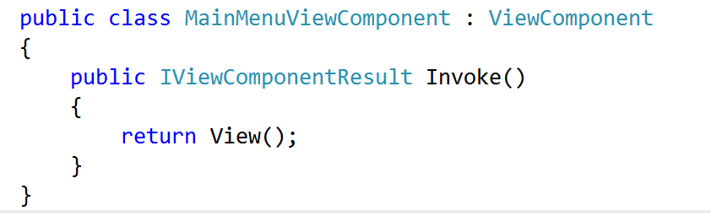
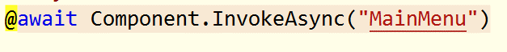
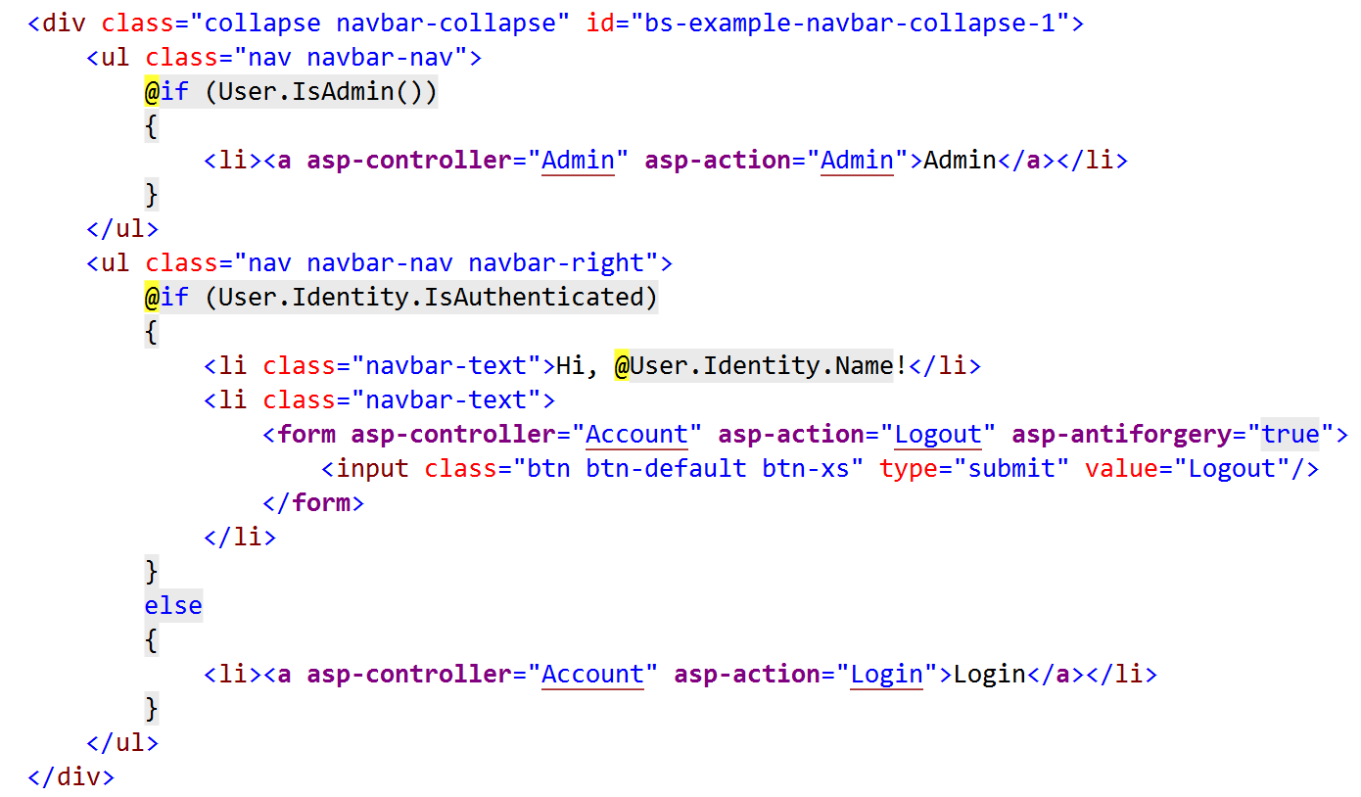
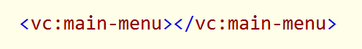
Embrace View Components

Slide 35

Client Code
36

Slide 36
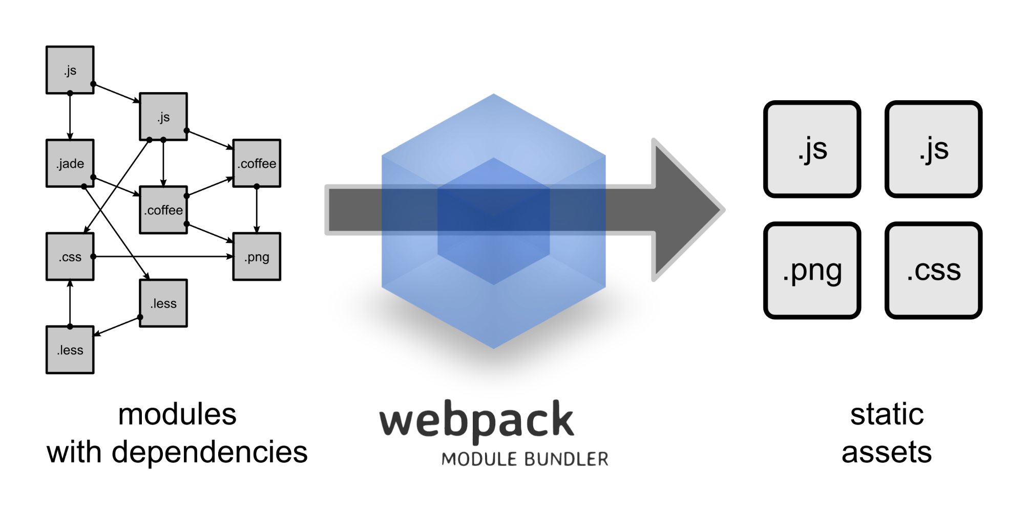
Use WebPack

Slide 37
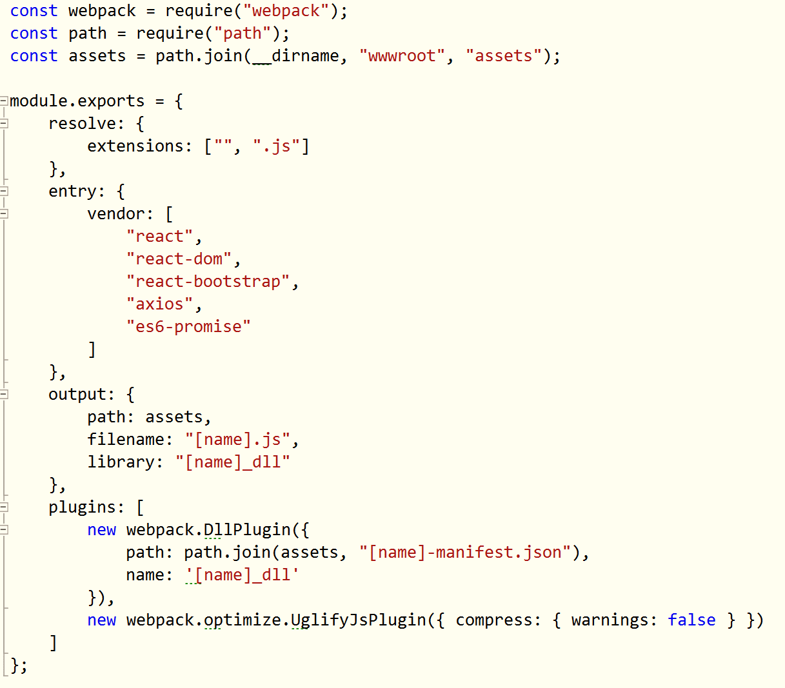
Use WebPack

Slide 38
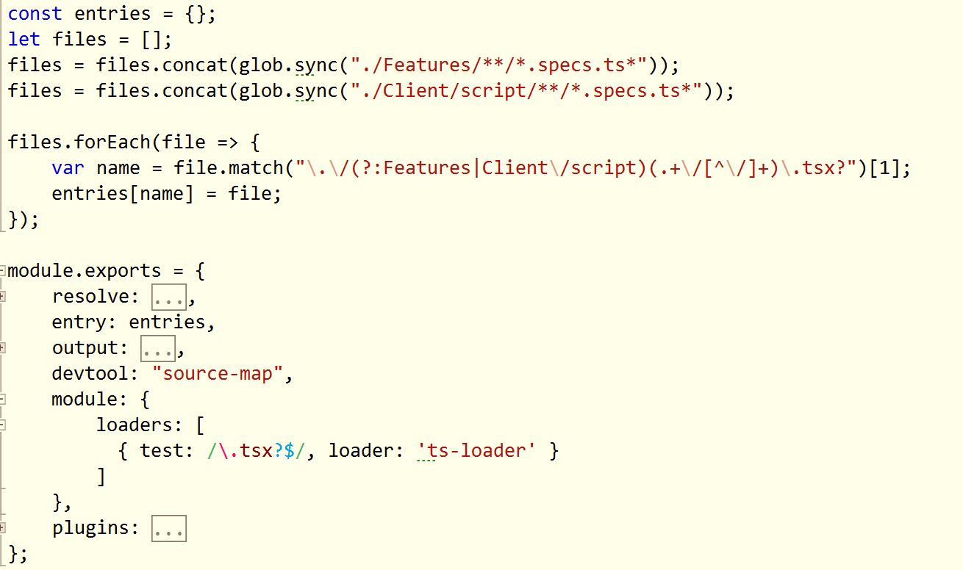
Use Multiple Configuration Files

Slide 39
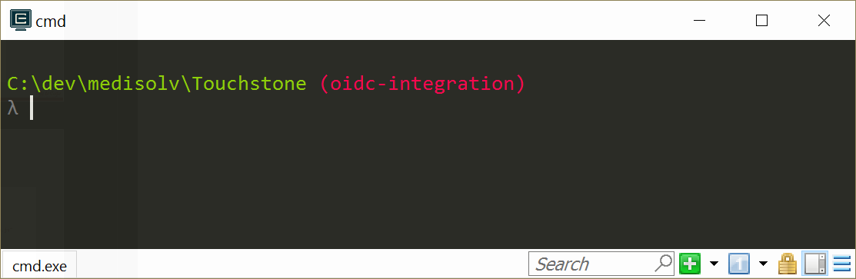
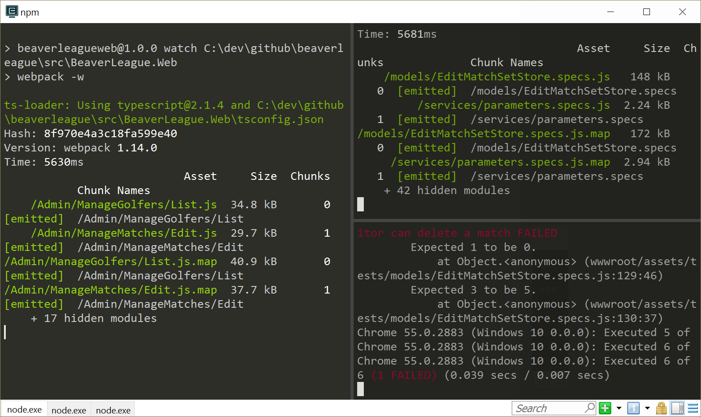

Use ConEmu or cmder

Slide 40


Client Code Layout

Slide 41

NuGet and npm Only

Slide 42


Use TypeScript

Slide 43

Use Visual Studio Code for TypeScript and ES2015+

Slide 44

wwwroot is your bin\ folder

Slide 45

Testing
50

Slide 46
A Single Test Project Is Not A Bad Idea
Web
Test
-
Web
Core
BEE
Core
BEE
(background
execution engine)

Slide 47


Use xUnit
Extensible, flexible, open source
Low ceremony
Good vocabulary

Slide 48







Try Hard to Avoid Mocks

Slide 49

Use the Microsoft.AspNetCore.Mvc.Testing

Slide 50

Define a Factory

Slide 51

More Integration Tests & Fewer Unit Tests

Slide 52

Make Integration Tests Easy

Slide 53

Make Use of AngleSharp

Slide 54

C#
Code
58

Slide 55

Use Environment.NewLine

Slide 56

Use Path.Combine

Slide 57

Be Aware of Environment Variables

Slide 58


Don’t Use the Async Suffix

Slide 59



Thanks!
scott@OdeToCode.com

